Slide 1
EMBODIED AI · WEEK 23
Experiment 2: Teaching It To Balance
The same robot, the same test — but now something learns
Last week the hand-tuned controller fell over at 0.20 m/s and no setting could fix it.
This week I train a policy and put it through the identical test.
Shaoqin Li · Prof. Yi Sun · CCNY

Slide 2
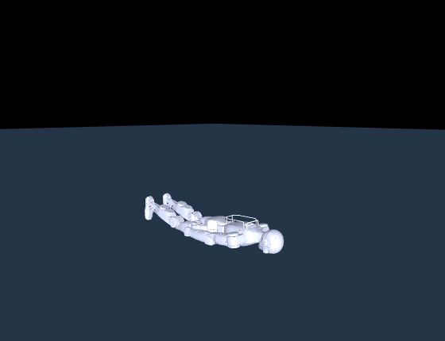
Where I left off
Experiment 1, in one sentence: a controller with two dials can hold the robot up, and nothing more.
WHAT I COULD NOT FIX
It survived a 0.20 m/s shove
from nobody. Not one of the
49 settings.
Because the controller only knows
one instruction — get back to the
pose I was told to hold.
Recovering from a shove means
choosing a DIFFERENT pose.
Stepping. Bending. Shifting weight.
Two dials cannot decide that.
▶ Experiment 1 — the hand-tuned controller, going down
So this week: can a neural network decide it? And can I prove the comparison is fair?

Slide 3
The ten steps
Three are about setting the problem up. Four are training. Three are measuring — and the measuring is where the care goes.
Turn walking into standing
Design the test
1
6
reuse the environment, zero the command
copy Experiment 1's protocol exactly
Decide what it can see
Does it stand?
2
7
45 numbers in, 12 out
20 episodes, no disturbance
Write the reward
What is it paid for?
3
8
say what good means, without saying how
answer the obvious criticism
Train it
Push it
4
9
4 environments, 3M steps, 49 minutes
the same shove that beat the PD controller
Read the curve
Compare
5
10
and the one number that looks like a bug
against the number I had to beat
grey = set up the problem teal = train it sand = measure it

Slide 4
STEP 1 / 10
Turn walking into standing
reuse the environment, zero the command
I did not write a new environment. I already had a walking task — standing is that task with the command set to zero.
WHAT I CHANGED
WHY THAT IS THE RIGHT MOVE
one flag: --fixed-cmd 0 0 0
The reward, the physics and the
observations stay byte-identical to
every other experiment.
So when I compare results later,
the difference is caused by the
policy — not by me quietly
changing the setup.
go nowhere forward
go nowhere sideways
do not turn
And there is a free bonus in it
The reward already contains a term that says “match the commanded velocity”. Set the command to zero and that term now means
“hold still on purpose”. I did not have to invent a single new reward term to turn a walking task into a standing one.

Slide 5
STEP 2 / 10
Decide what it can see
45 numbers in, 12 out
The policy gets 45 numbers and produces 12. That is the entire interface.
IN — 45 numbers
OUT
3
how fast the body is rotating
12 leg joint targets
3
which way is down, from the robot's view
a new pose, 50 times a second
3
what I am asking for — all zeros today
THIS IS THE WHOLE DIFFERENCE
12
where each leg joint is
The PD controller had one pose,
fixed, forever.
This one picks a new target every
20 milliseconds — so it CAN decide
to crouch, or shift its weight.
Whether it learns to is the
experiment.
12
how fast each leg joint is moving
12
what it did on the last step

Slide 6
STEP 3 / 10
Write the reward
say what good means, without saying how
The reward is how I say “good” without saying how. Fourteen terms — three of them do nearly all the work.
+1.5
match the commanded velocity
command is zero, so: hold still
THE TRAP
match the commanded turn rate
do not spin
The moment I put a “still
standing” bonus in there,
I invited one criticism:
+0.5
+0.15
still standing
a small bonus each step
“your robot didn't
learn to balance —
it learned to collect
the bonus.”
-5.0
stay upright
penalty for tilting
-10.0
hold your hip height
penalty for sinking
That is a fair objection,
and no training curve
can answer it.
I answer it in Step 8.
small
do not waste effort
penalty on torque

Slide 7
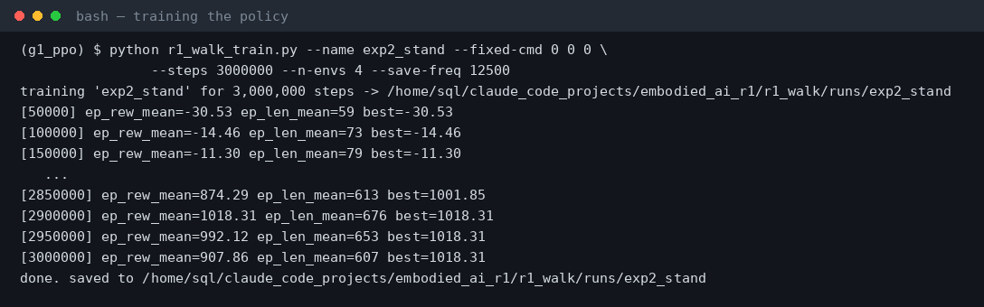
STEP 4 / 10
Train it
4 environments, 3M steps, 49 minutes
Then I trained it — on the same laptop, with no GPU.
THE SETUP
PPO
4 environments
3,000,000 steps
49 minutes
0 GPUs
Randomisation is ON while
training — friction, mass,
motor gains, and a random
shove every few seconds.
It is being bullied on
purpose, so it learns
something robust.

Slide 8
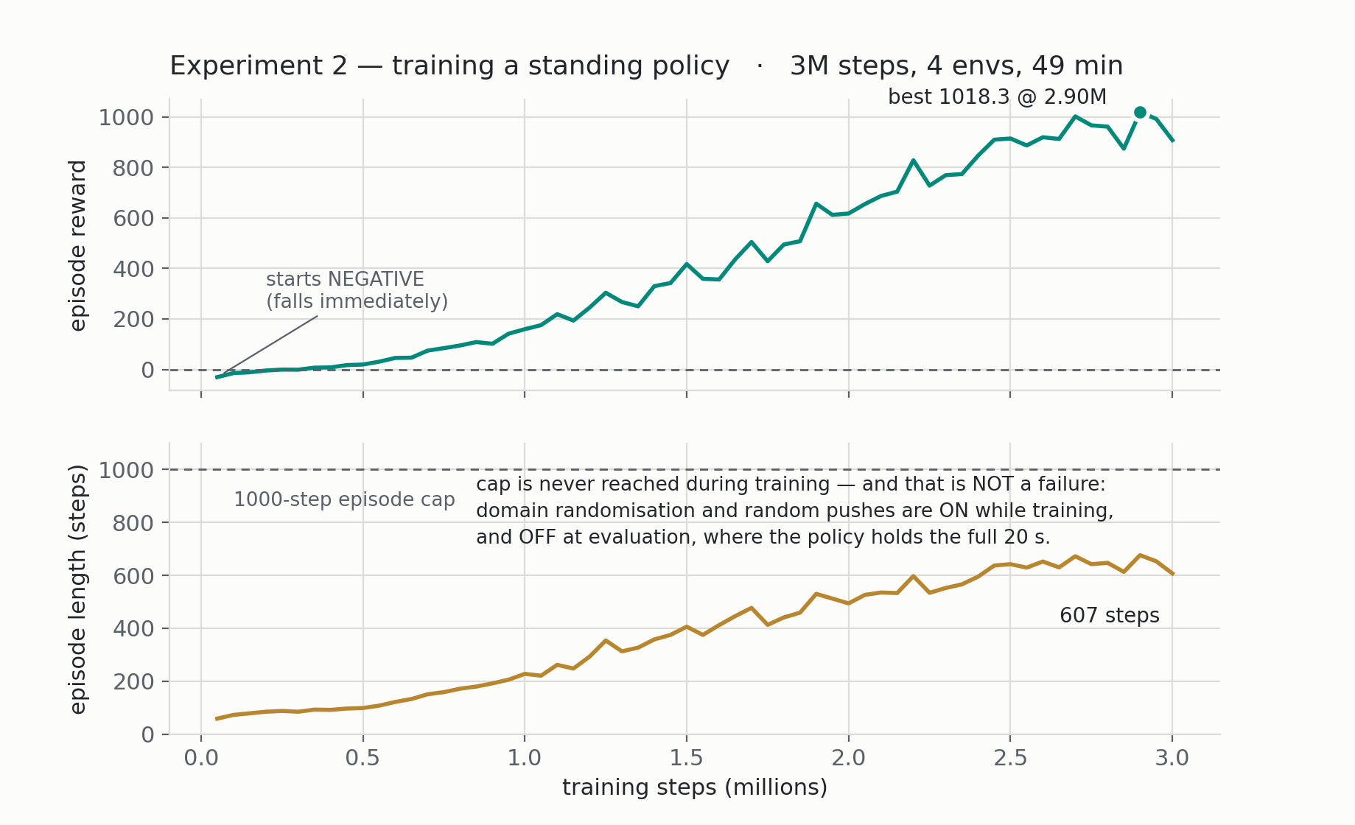
STEP 5 / 10
Read the curve
and the one number that looks like a bug
The real training log — all 60 checkpoints, nothing smoothed.
The thing that looks like a bug: episode length ends at 676 against a cap of 1000.
Read literally, that says it still falls a third of the time. It does not — randomisation and random shoves are ON during training and OFF during the test.

Slide 9
STEP 6 / 10
Design the test
copy Experiment 1's protocol exactly
Before looking at any result, I decided how to test it — and copied Experiment 1's protocol exactly.
Randomisation
turned OFF
so the only disturbance is the one I inject
Push protocol
identical to Exp 1
same impulse, same moment, same magnitudes
Episodes
20 undisturbed, 5 per push
one run proves nothing
Checkpoint
best, not last
chosen on training reward — I say so openly
Metrics
three, not one
survival, tilt, and the reward breakdown
The second row is the one that matters.
If I had invented a nicer test for my own policy, the comparison to 0.15 m/s would be worthless. Same robot, same shove, same measurement.

Slide 10
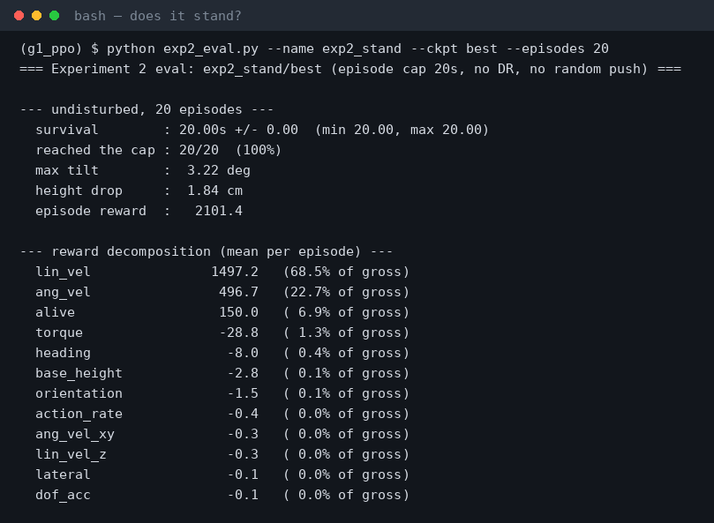
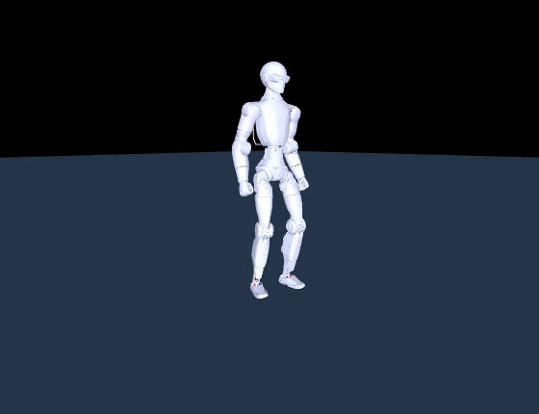
STEP 7 / 10
Does it stand?
20 episodes, no disturbance
First question: does it actually stand?
▶ 8 s, undisturbed — it barely moves
20 of 20 episodes reached the full 20 seconds. Maximum tilt across all of them: 3.22 degrees.

Slide 11
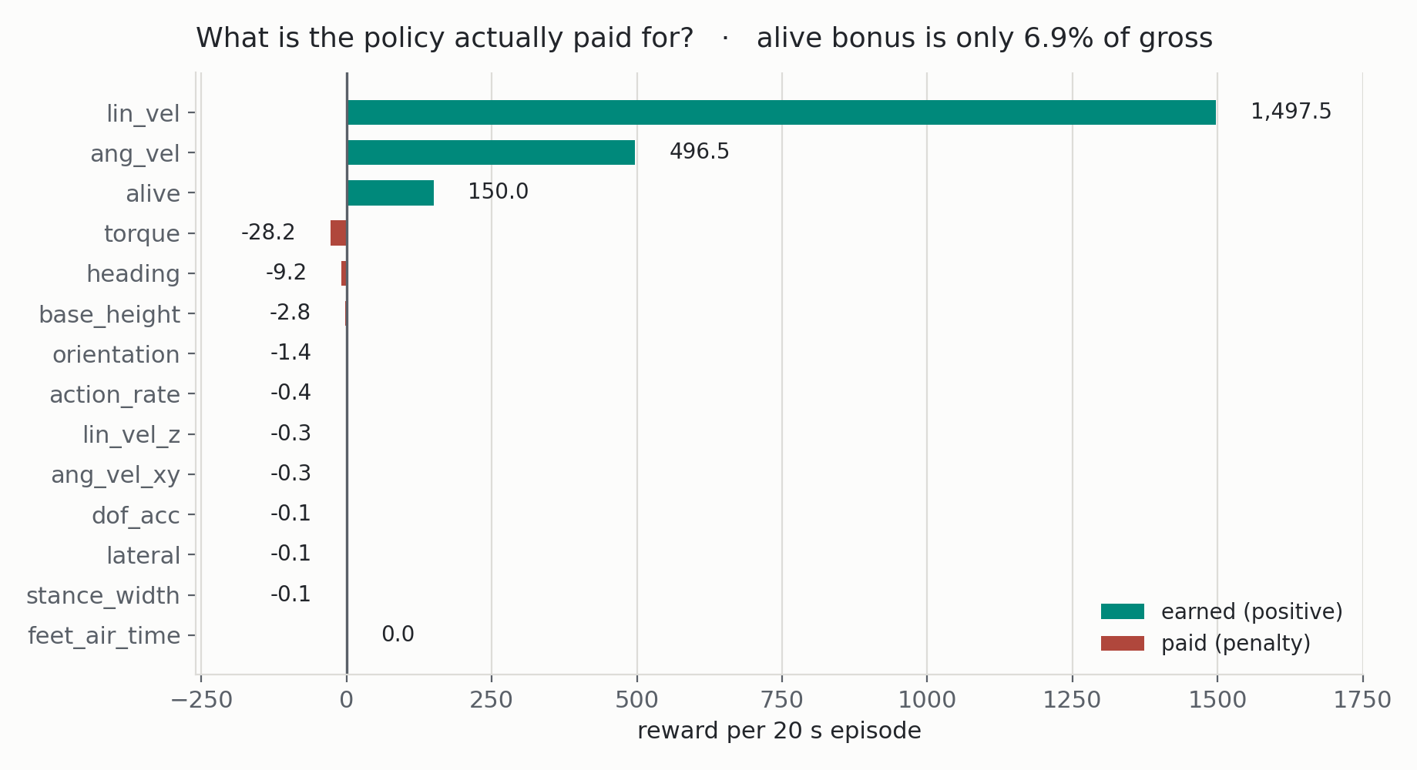
STEP 8 / 10
What is it paid for?
answer the obvious criticism
Second question — the one I set up back in Step 3. Is it just collecting the survival bonus?
THE ANSWER
6.9%
of the score comes from
the survival bonus.
91% comes from velocity
tracking — from holding
still ON PURPOSE, which
is the actual task.
If it were gaming the
bonus, these would be
the other way round.
I raised this objection myself, before showing the result. That is the difference between a demo and an experiment.

Slide 12
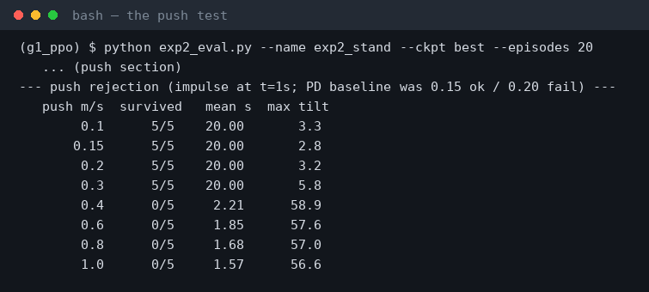
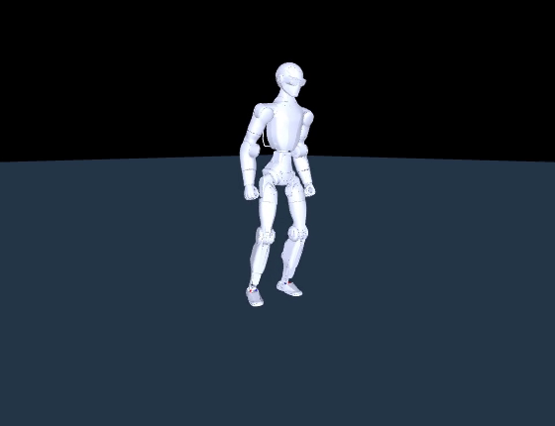
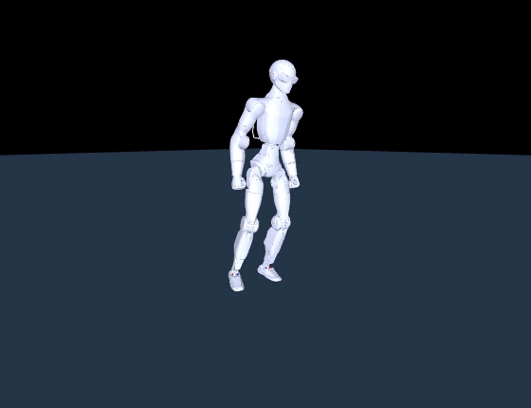
STEP 9 / 10
Push it
the same shove that beat the PD controller
Third question: the same shove that beat the hand-tuned controller.
▶ 0.30 m/s — it stays up
▶ 0.40 m/s — down in 2.2 s
Survives 0.30 m/s, five times out of five. Falls at 0.40. The hand-tuned controller survived 0.15.

Slide 13
STEP 10 / 10
Compare
against the number I had to beat
Same robot. Same shove. Same measurement. The only thing that changed is what decides the pose.
EXPERIMENT 1 — two dials
EXPERIMENT 2 — a trained policy
0.15 m/s
0.30 m/s
survives
survives
falls at 0.20
falls at 0.40
and no setting of the two dials
changes that
twice the disturbance, on a test
I did not get to design
Learning roughly doubled it — and the reason is structural, not incremental.
The PD controller restores one fixed pose. The policy chooses a new pose fifty times a second — so it can crouch, or shift its weight,
or do whatever the shove requires. That is a different kind of thing, not a better-tuned version of the same thing.

Slide 14
What I found
✓
Learning beats hand tuning, measurably
0.30 vs 0.15 m/s on an identical test
✓
It is not gaming the reward
the survival bonus is 6.9% of the score; velocity tracking is 91%
✓
A training curve cannot tell you it worked
reward went up — that says nothing about standing, steadiness or shoves
✓
The comparison is the hard part, not the training
copying Experiment 1's protocol is what makes the number mean anything
✓
Still only a simulator
whether this transfers to hardware is a question I have not answered yet
Every number came off my own screen, in the order you just saw it.

Slide 15
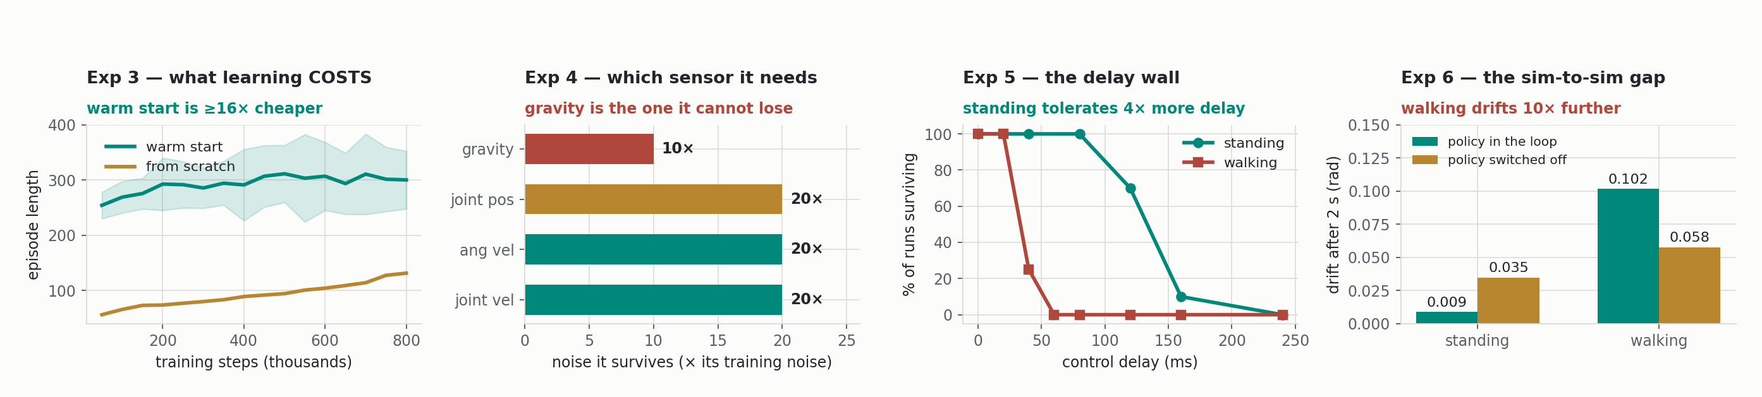
What comes next — experiments 3 to 6
All four are already run — these are the real results, not a plan. I will take one per week from here.
3
What does learning cost?
4
Which senses does it need?
5
Why is a real robot harder?
6
Does the simulator lie?
Starting from a policy I already have, instead of from nothing, is at least 16× cheaper.
I corrupt one sensor at a time. Gravity is the only one it cannot do without.
I add control delay. Standing survives 80 ms; walking dies at 40.
Same policy, two physics models — then measure how far apart they drift.

Slide 16
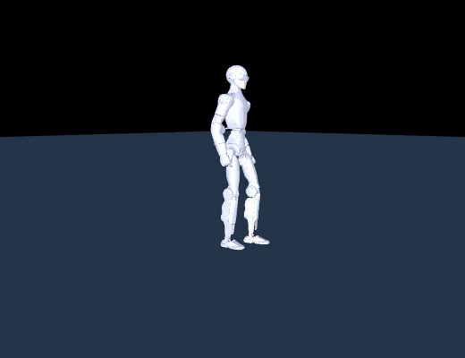
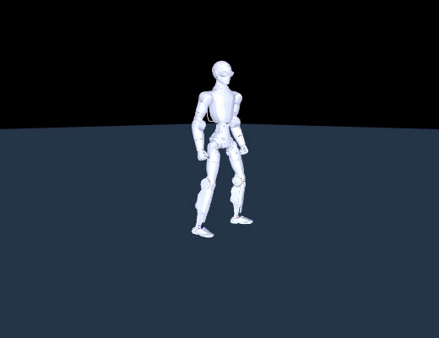
EXPERIMENT 3
What does learning COST?
I trained the same walking task twice — identical environment, reward, seeds and step budget. The only difference: one started from a policy I already had, the other from nothing.
▶ from scratch — down in 2.1 s
▶ warm start — still going at 5 s
Same number of training steps. Same everything else.

Slide 17
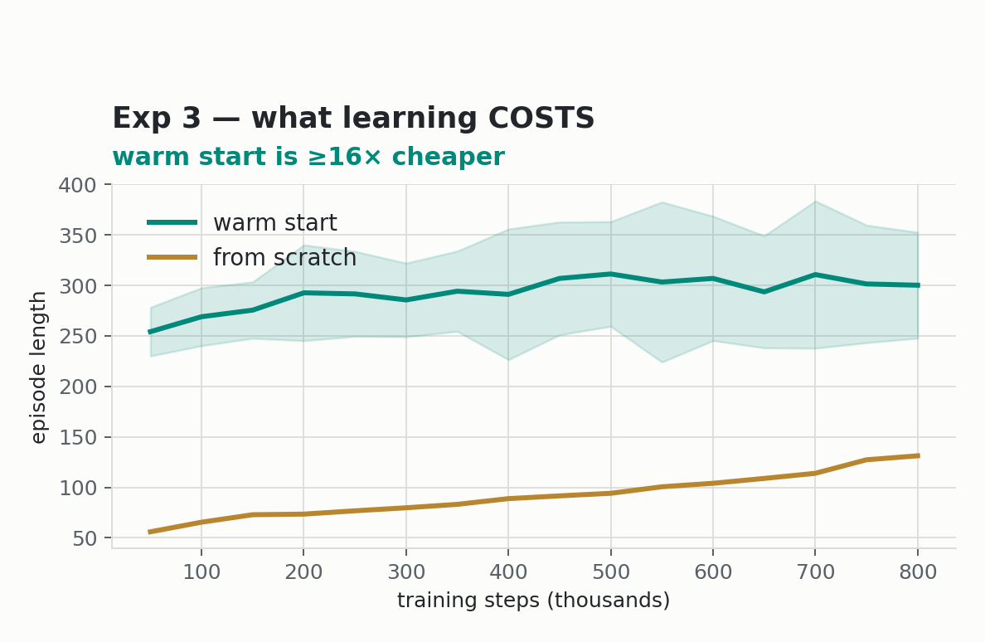
EXPERIMENT 3
What the numbers say
1
At least 16× cheaper
the warm-started run at 50,000 steps is already past where the from-scratch run ended at 800,000
2
Well clear of the noise
the gap is 3.6 to 11.6 pooled standard deviations, across 15 runs per side
3
But the advantage shrinks
4.5× ahead early, 2.3× by the end — a head start, not a higher ceiling
Full walkthrough of Experiment 3 in a coming week.

Slide 18
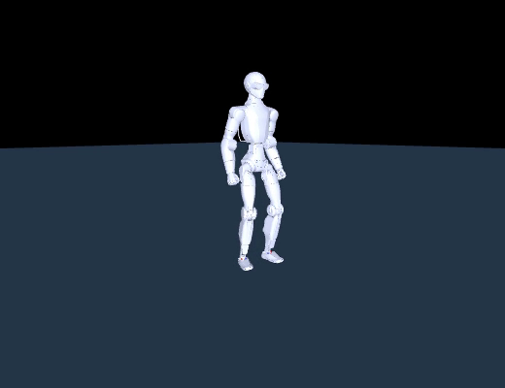
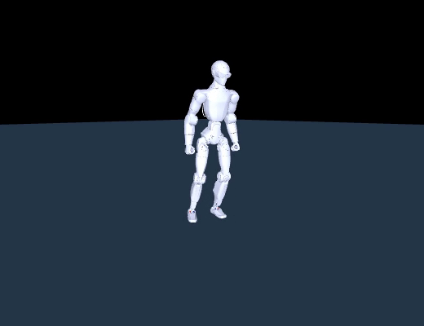
EXPERIMENT 4
Which senses does it actually need?
I froze the standing policy and corrupted one sensor at a time — dosing the noise in multiples of the noise that channel already saw during training.
▶ all senses intact
▶ gravity sense corrupted — down in 2.4 s
Same policy, same weights. Only the incoming sensor data changed.

Slide 19
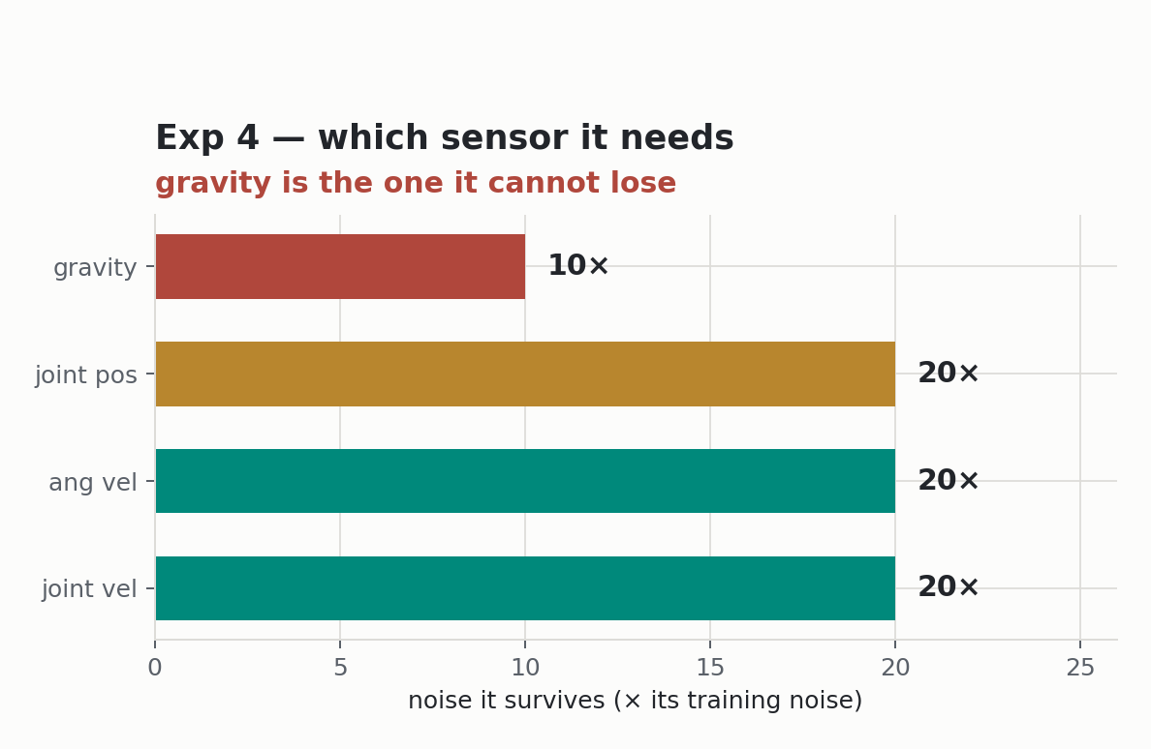
EXPERIMENT 4
What the numbers say
1
Gravity is the one it cannot lose
the only channel that breaks below 20× — it is the sole absolute reference for which way is up
2
Everything else is remarkably tough
joint angles, joint speeds and rotation rate all survive 10× their training noise
3
So sensing is not the weak link
which matters, because it points the sim-to-real problem at the physics instead
Full walkthrough of Experiment 4 in a coming week.

Slide 20
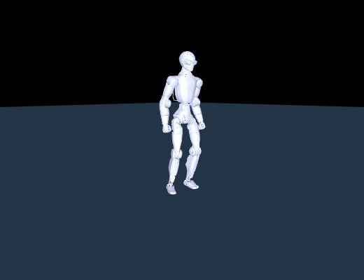
EXPERIMENT 5
Why is a real robot harder than a simulator?
A real robot never acts on fresh information — there is always a delay. So I injected a fixed delay into a frozen policy and raised it until the robot fell.
▶ no delay — holds
▶ 160 ms of delay — down in 3.8 s
Identical policy. The only change is how stale its information is.

Slide 21
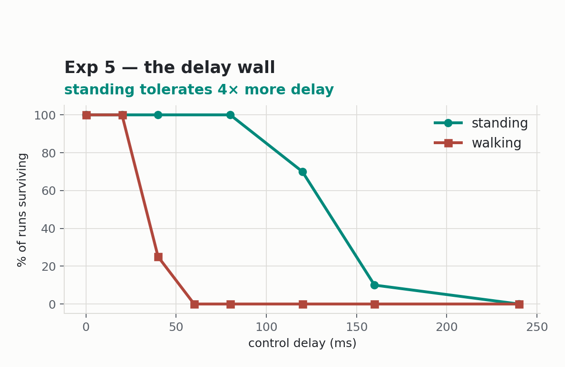
EXPERIMENT 5
What the numbers say
1
Standing tolerates 80 ms; walking dies at 40
a 4× difference between two policies on the same robot
2
Because walking is a moving target
standing holds one pose; walking has to hit the right phase, and delay shifts phase
3
This is my best proxy for real hardware
the network round-trip on the real robot is worth roughly 40 ms
Full walkthrough of Experiment 5 in a coming week.

Slide 22

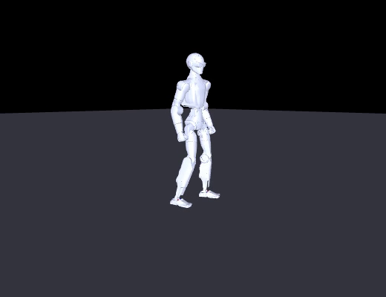
EXPERIMENT 6
Does the simulator lie?
I took one frozen policy and ran it in two different physics models from an identical starting state — then measured how far apart they ended up.
▶ physics model A
▶ physics model B
Same weights, same start, same commands. Camera fixed so you can see them drift apart.

Slide 23
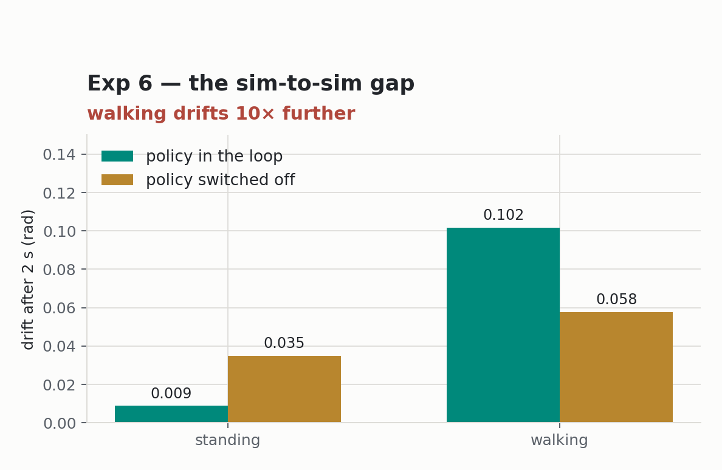
EXPERIMENT 6
What the numbers say
1
The models disagree by a fixed amount
with the policy switched off, the difference doubles every 0.5–0.7 seconds
2
Feedback contains it — but not equally
standing holds the drift to 0.009 rad; walking only to 0.102 — about 10× worse
3
And walking's small error accumulates
after 20 seconds the two simulations are 2.8 metres and 58 degrees apart, with neither having fallen
Full walkthrough of Experiment 6 in a coming week.

Slide 24
Where this is going
Two experiments down. Each one exists to make the next one measurable.
Exp 1
gave me a number to beat
0.20 m/s
Exp 2
beat it, on the same test
0.40 m/s
Exp 3–6
ask what it costs, what it needs,
and where the simulation stops being true
Questions

